Slide 1
Percentiles:
FOUR axes:
Size as first axis:
p. 2 - cost-based coloring
p. 3 - size-based coloring
Cost as first axis:
p. 4 - cost coloring
THREE axes:
p.10 – cost coloring
p.11 – size coloring
Discrete values:
(all are four axes)
Size as first axis:
Quality and size discrete - p.6
Only quality discrete- p.7
Cost as first axis, discrete:
Quality and sizediscrete, p.8

Slide 2
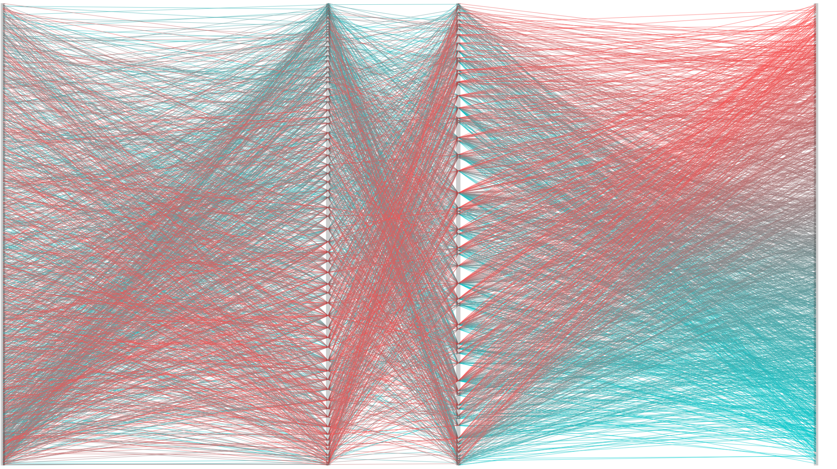
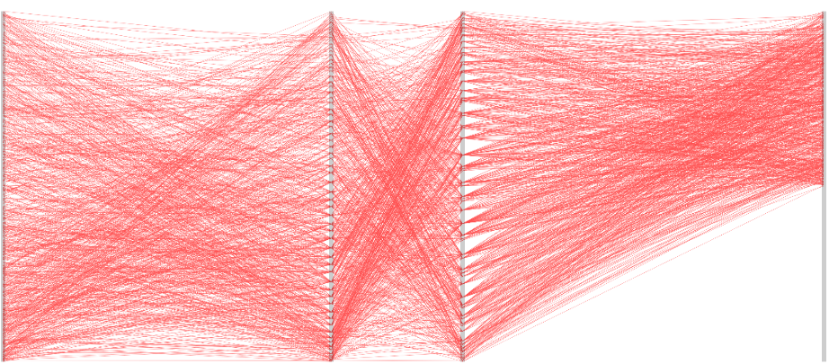
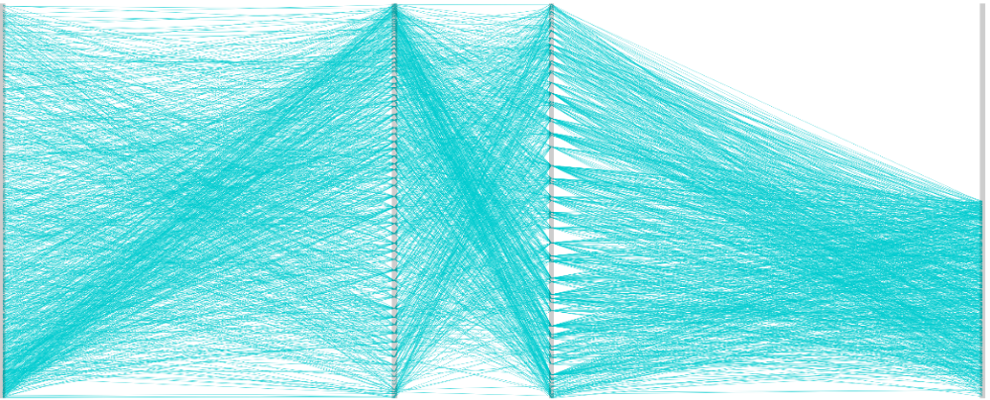
SIZE
patient experience
outcome
COST
high
low

Slide 3
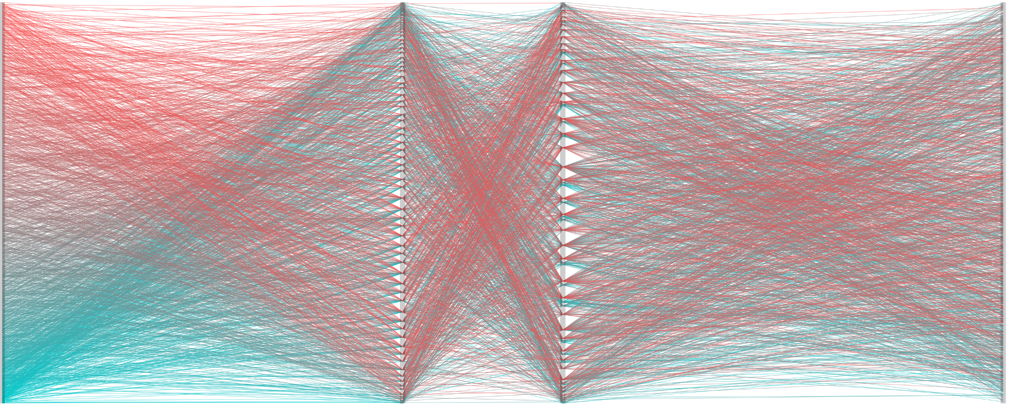
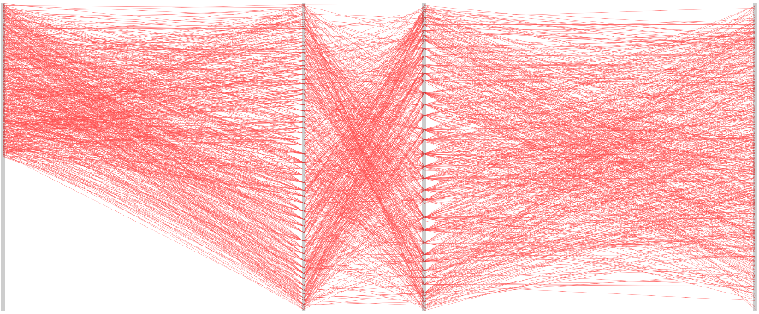
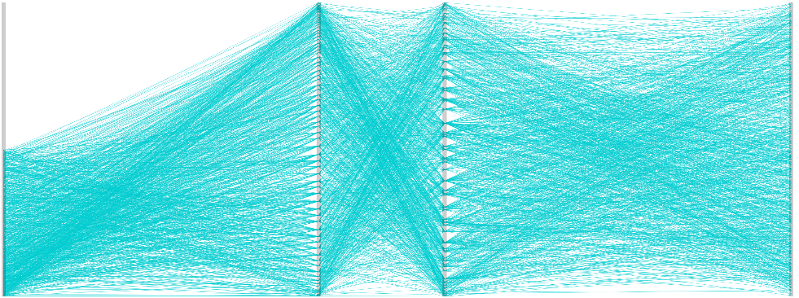
SIZE
patient experience
outcome
COST
high
low

Slide 4
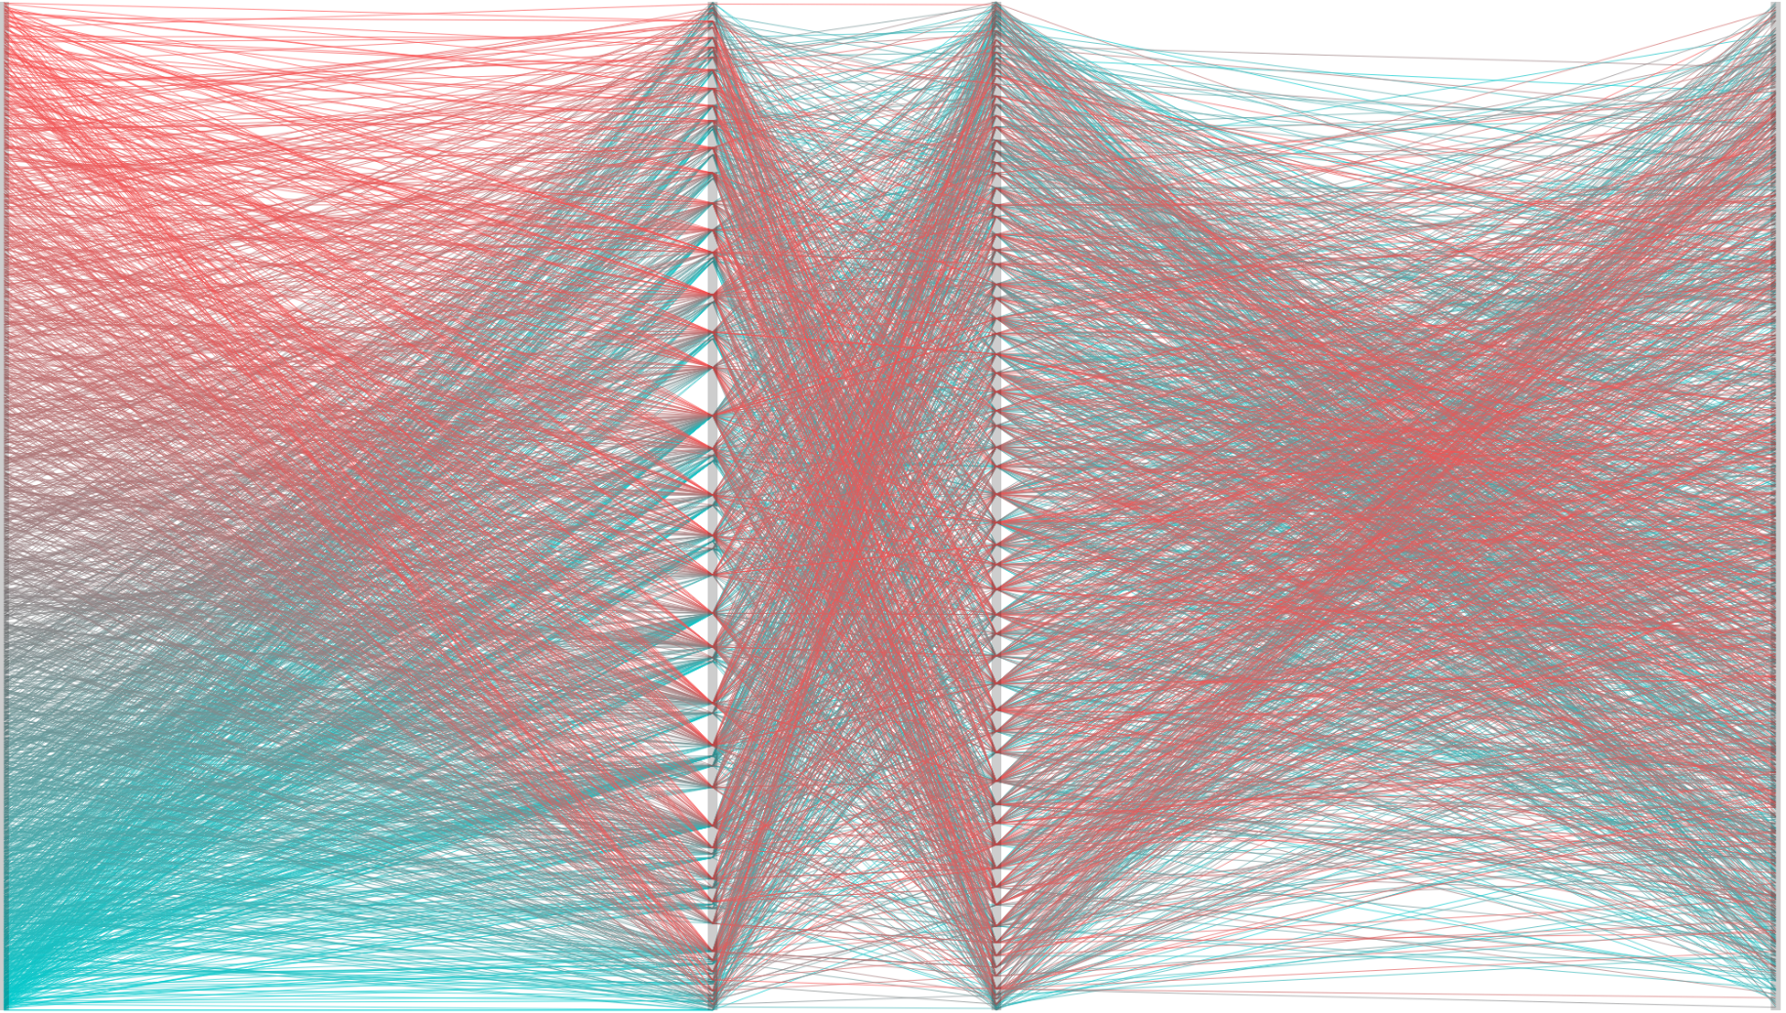
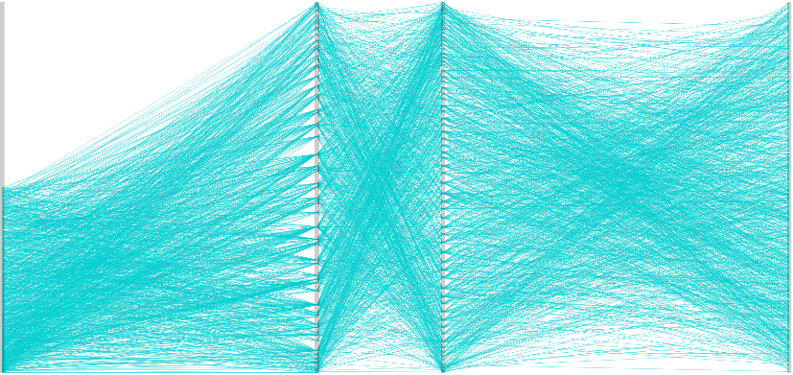
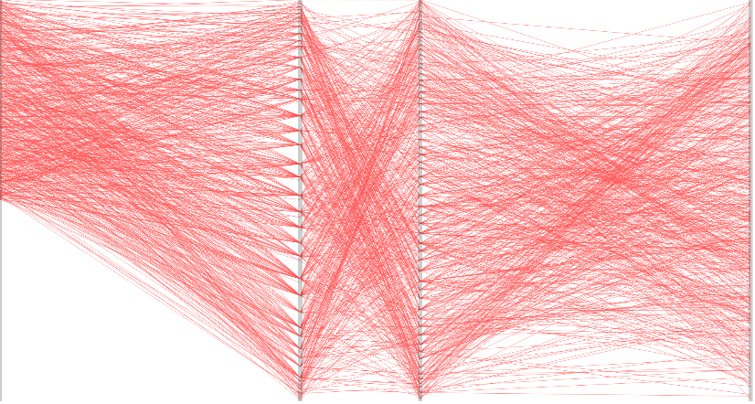
SIZE
outcome
patient experience
COST
high
low

Slide 5
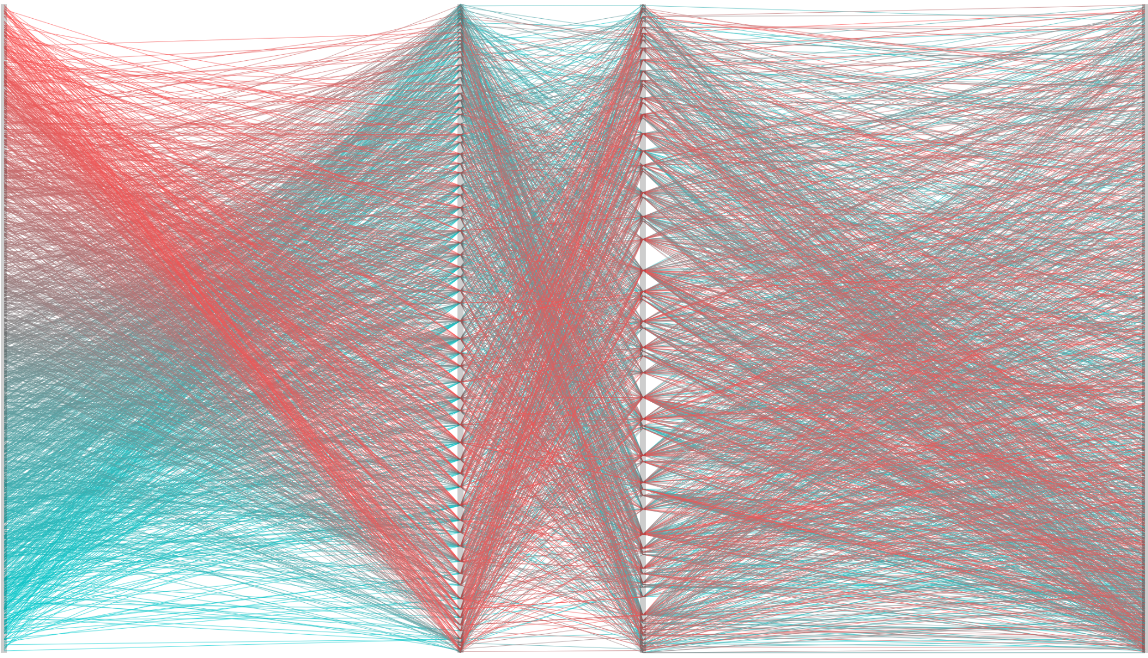
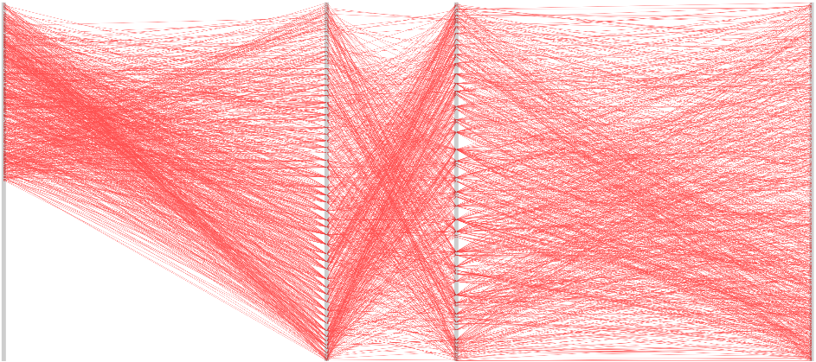
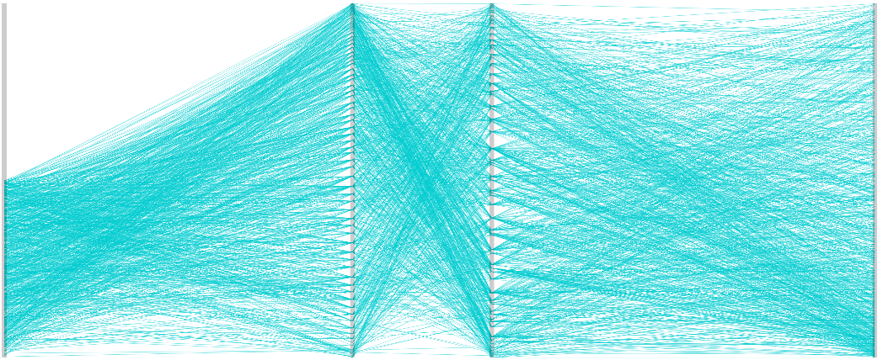
COST
patient exp
outcome
SIZE
high
low

Slide 6



SIZE
outcome
patient exp
COST
high
low

Slide 7
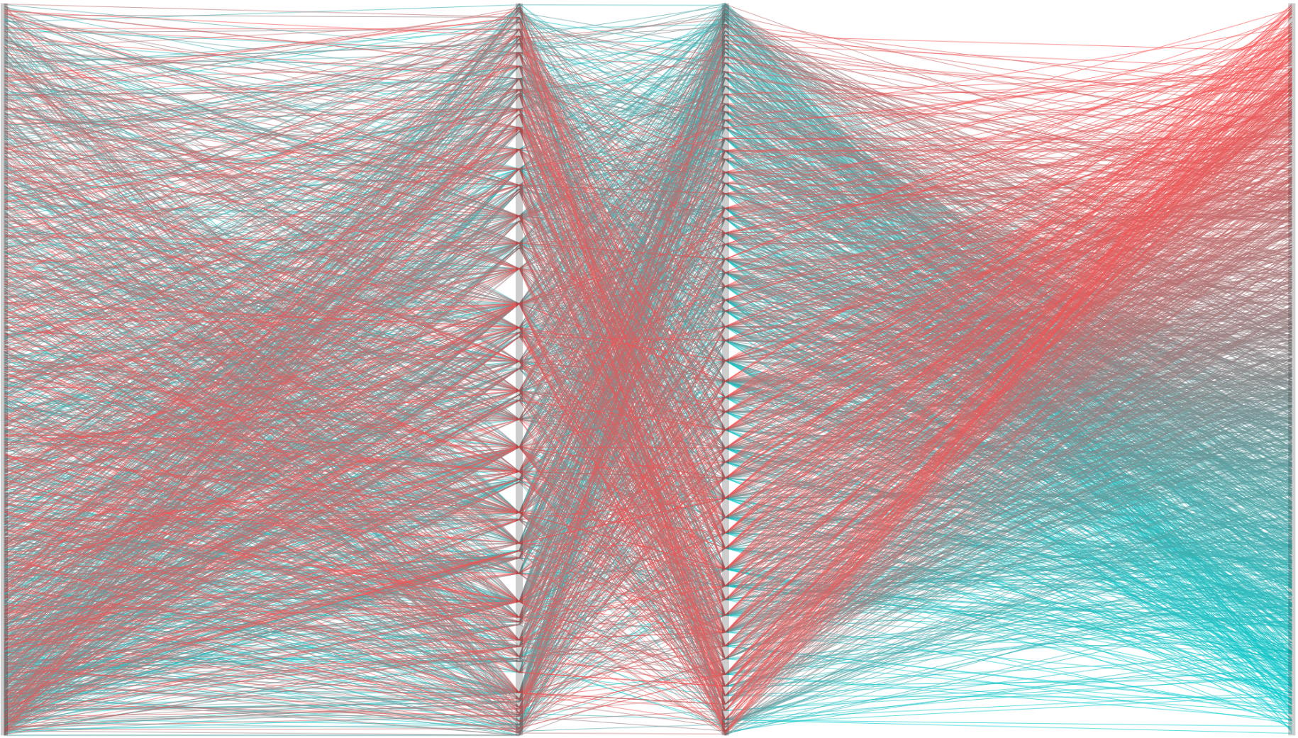
SIZE
outcome
patient exp
COST
high
low

Slide 8
DISCRETE VALUES

Slide 9
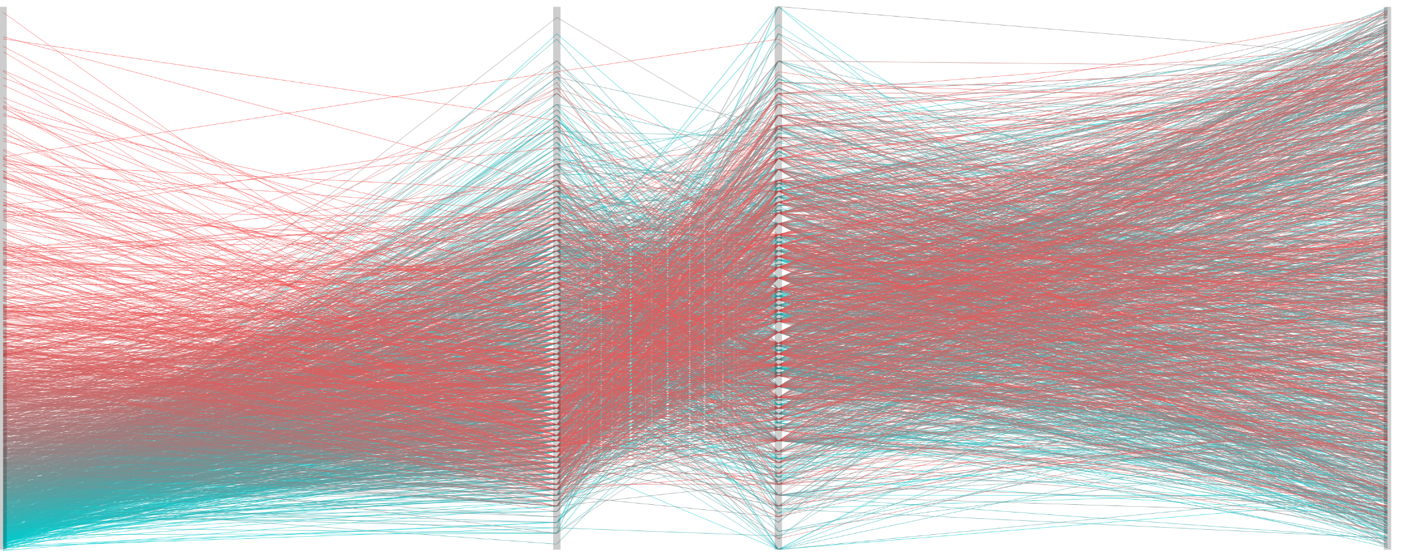
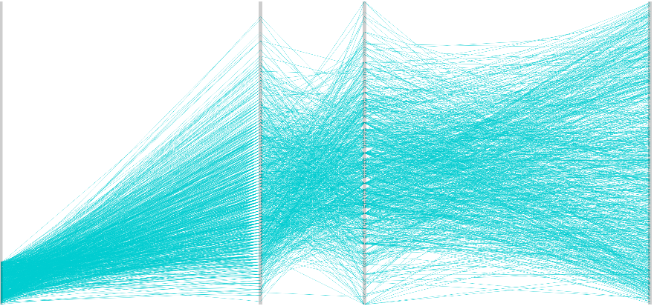
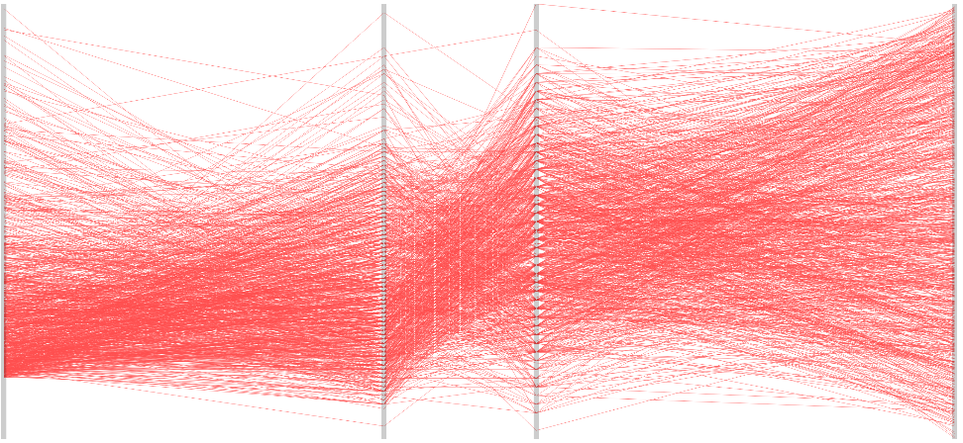
SIZE
patient experience
outcome
COST
high
low

Slide 10
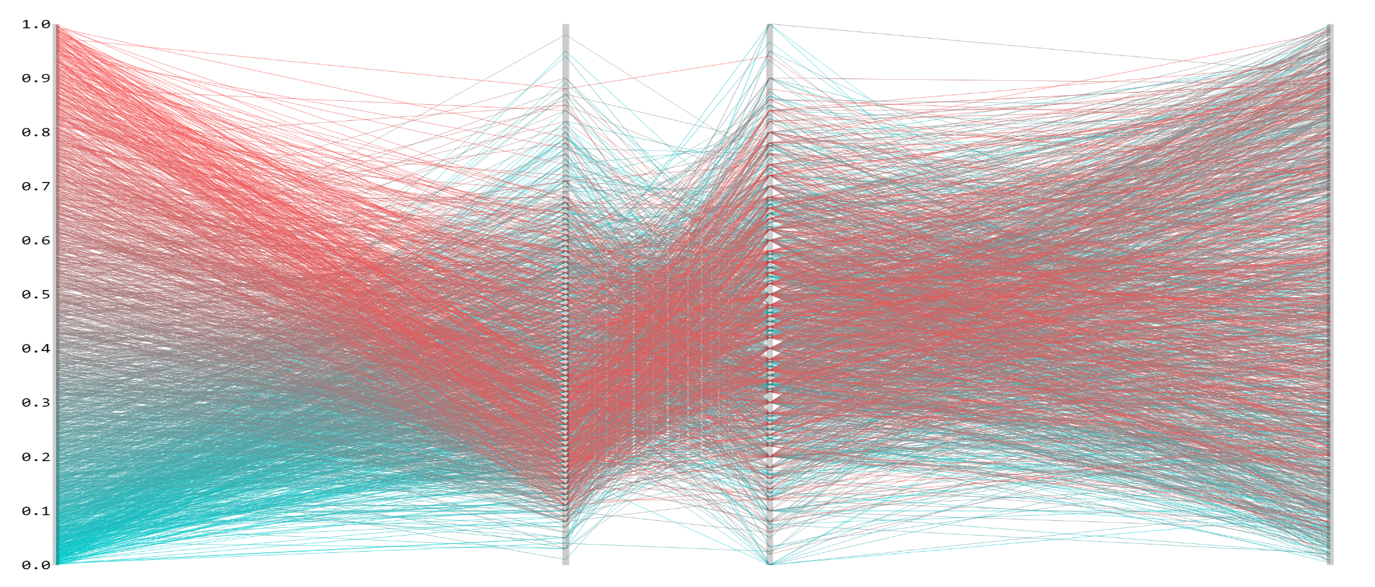
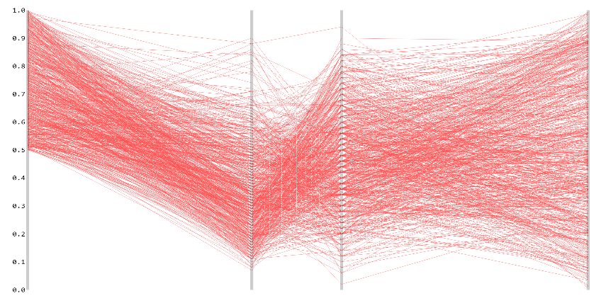
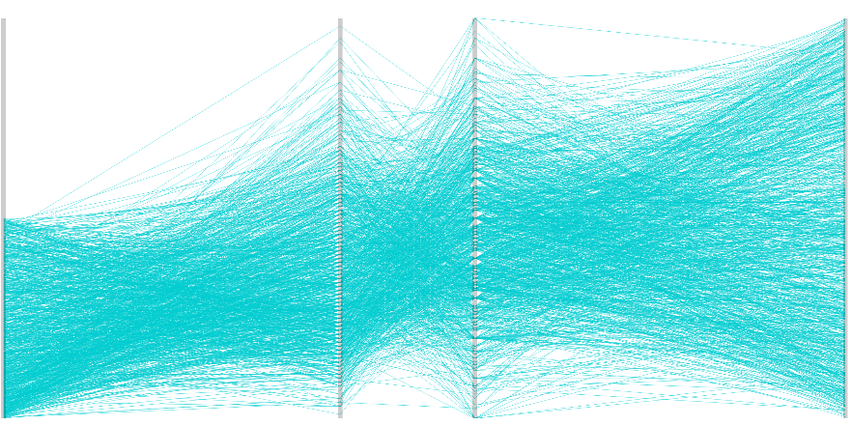
SIZE
patient experience
COST
outcome
high
low

Slide 11
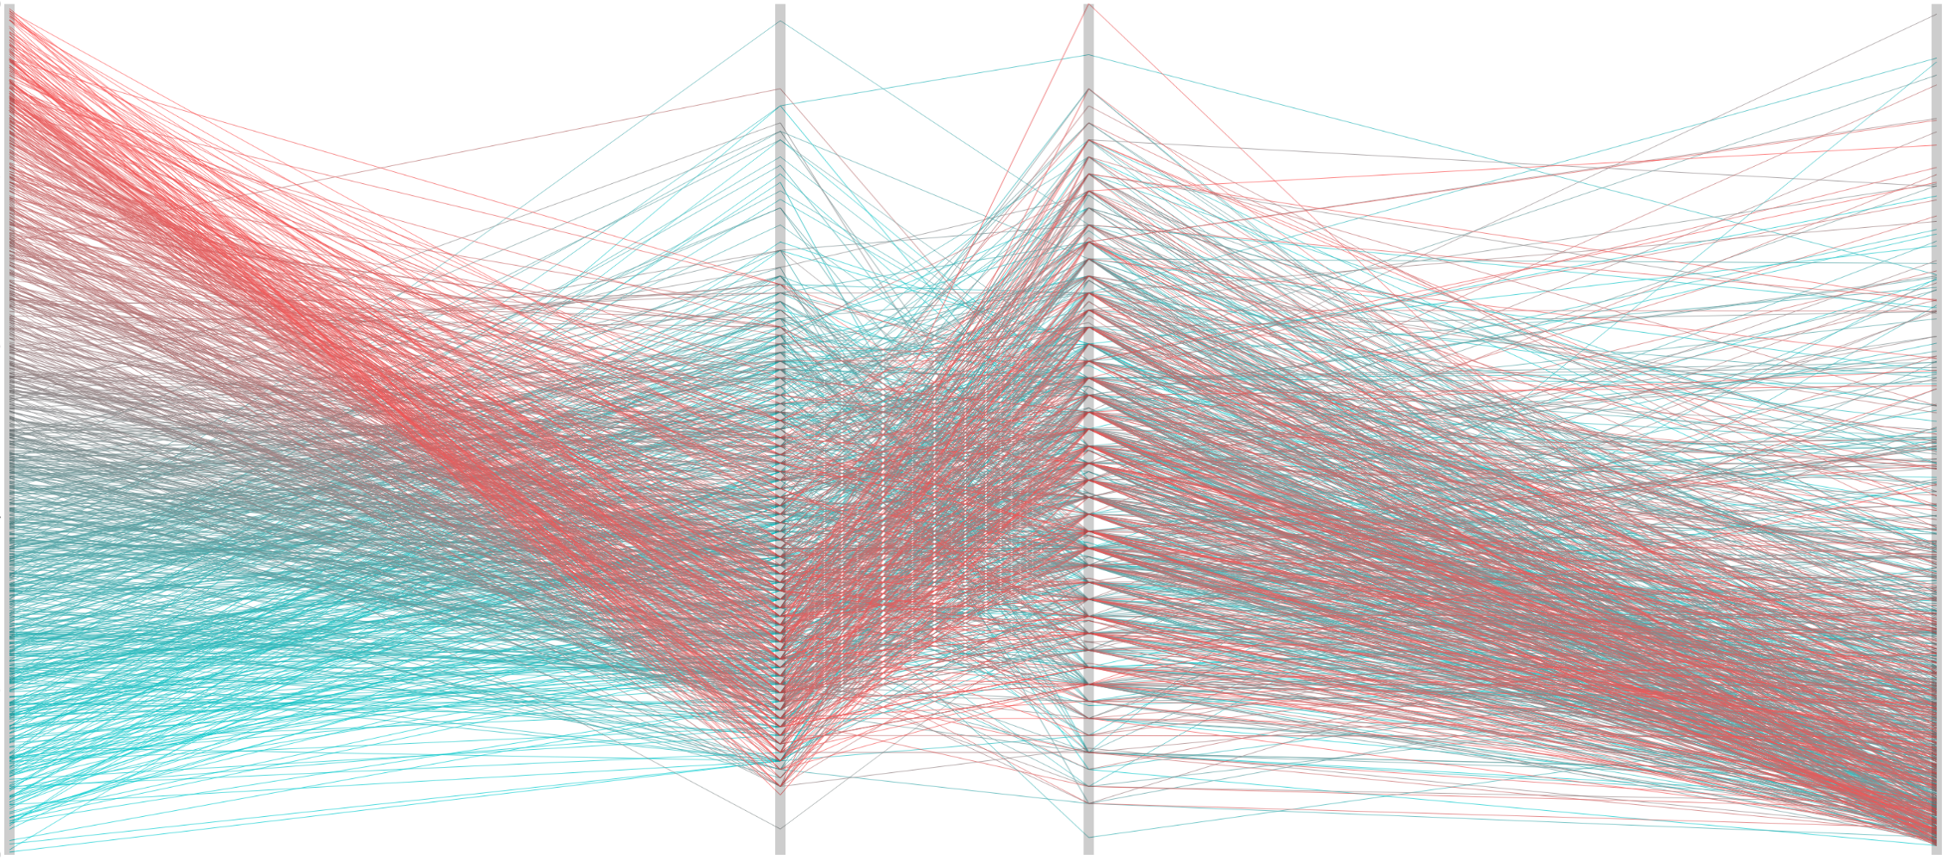
COST
patient experience
outcome
SIZE
high
low

Slide 12
THREE AXES

Slide 13
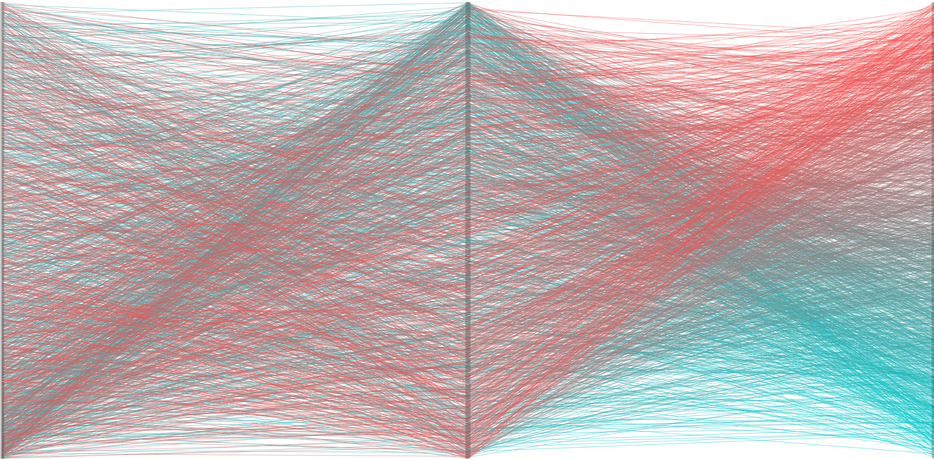
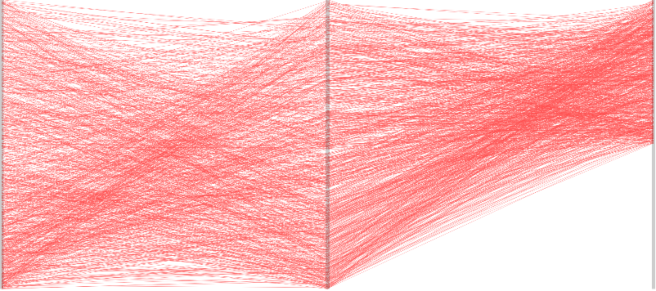

SIZE
QUALITY
COST
high
low

Slide 14
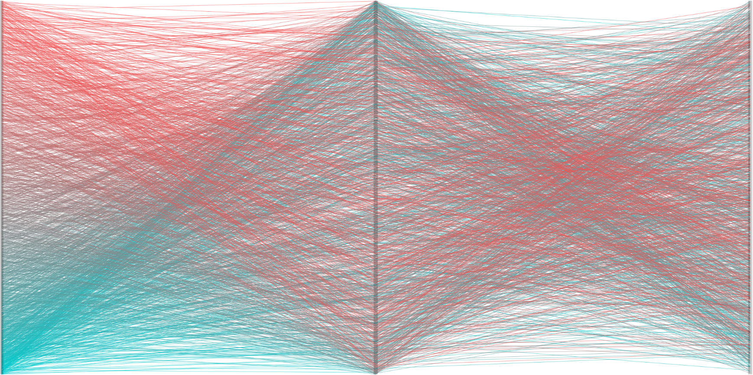
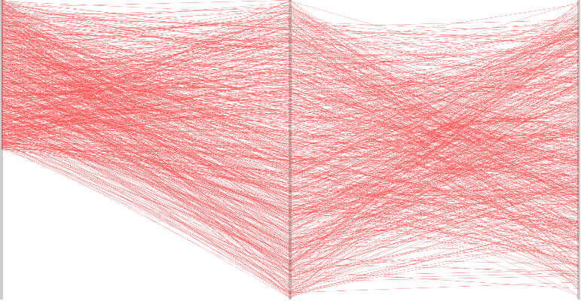
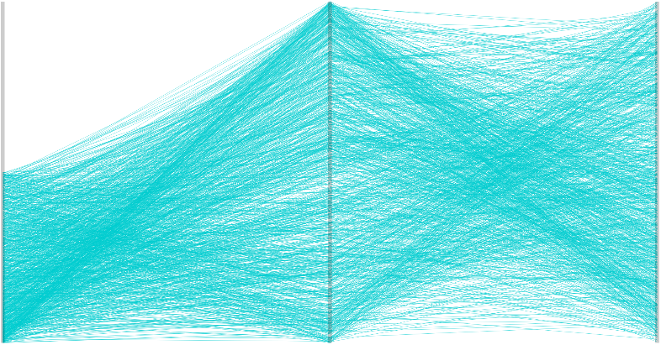
SIZE
QUALITY
COST
high
low

Slide 15
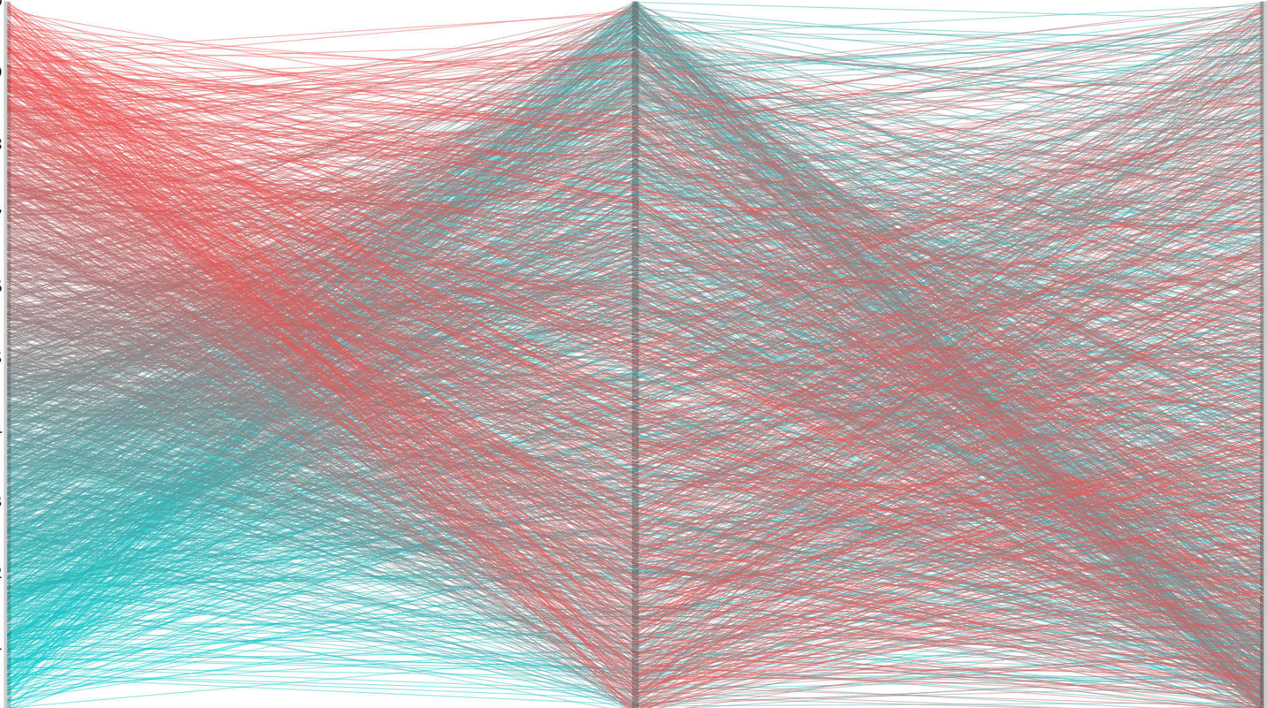
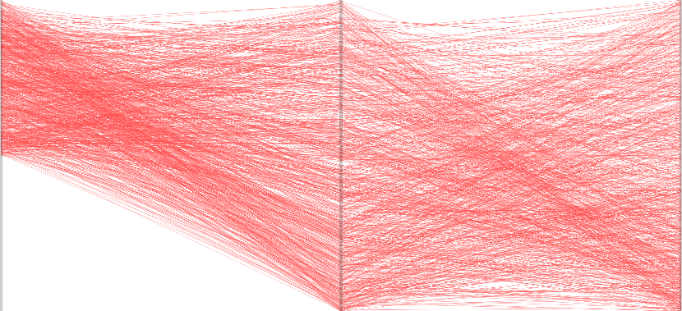

COST
QUALITY
SIZE
high
low

Slide 16
bloopers

Slide 17
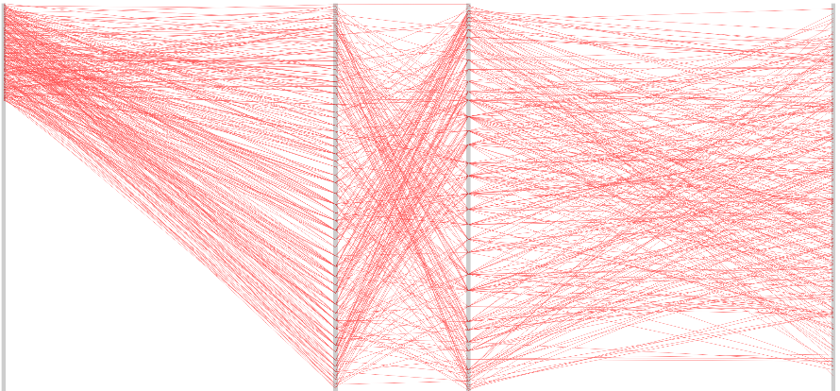
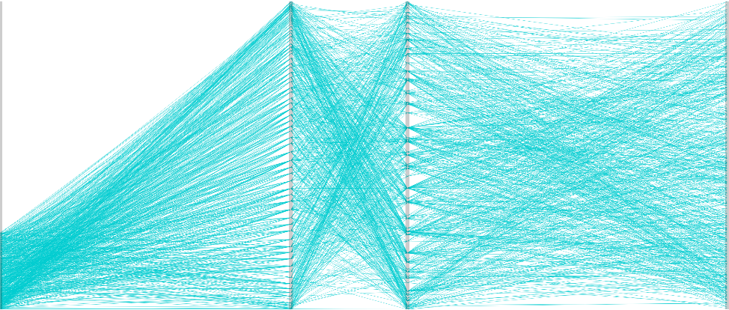
SIZE
patient experience
outcome
COST
high
low

Slide 18
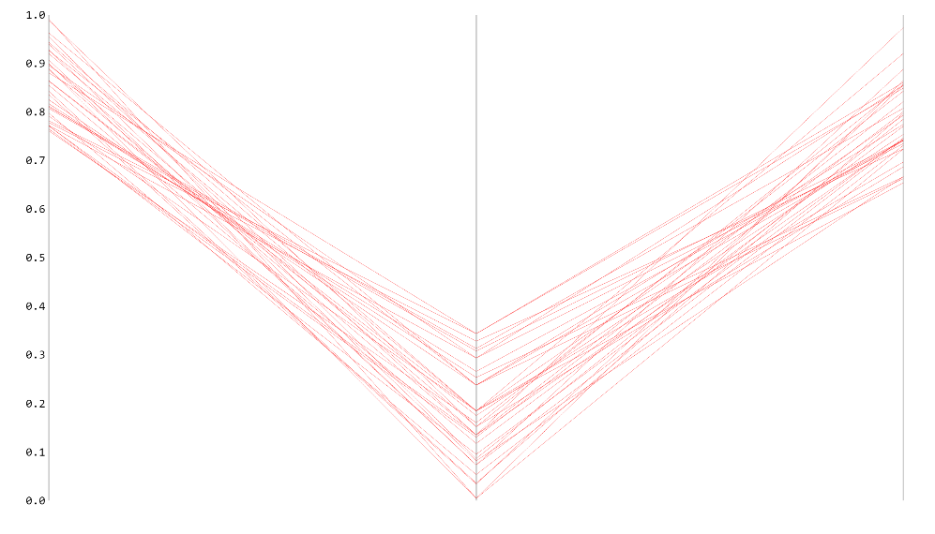
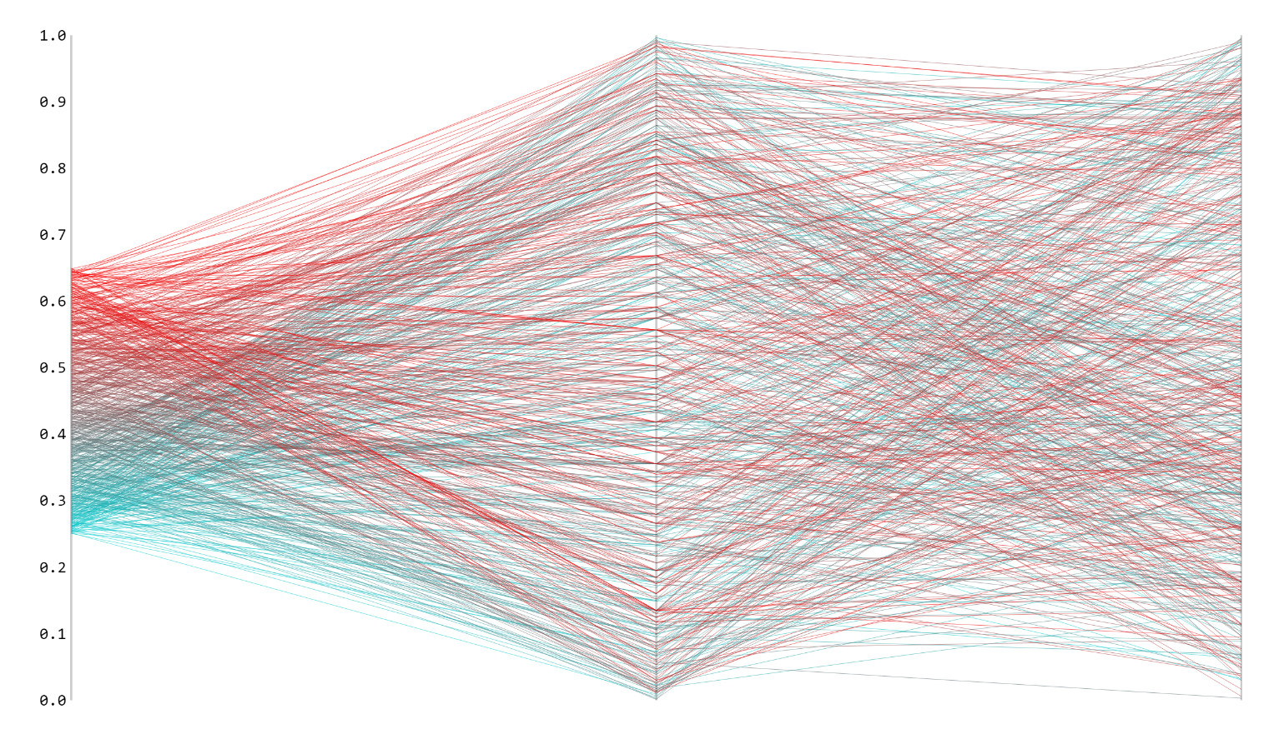
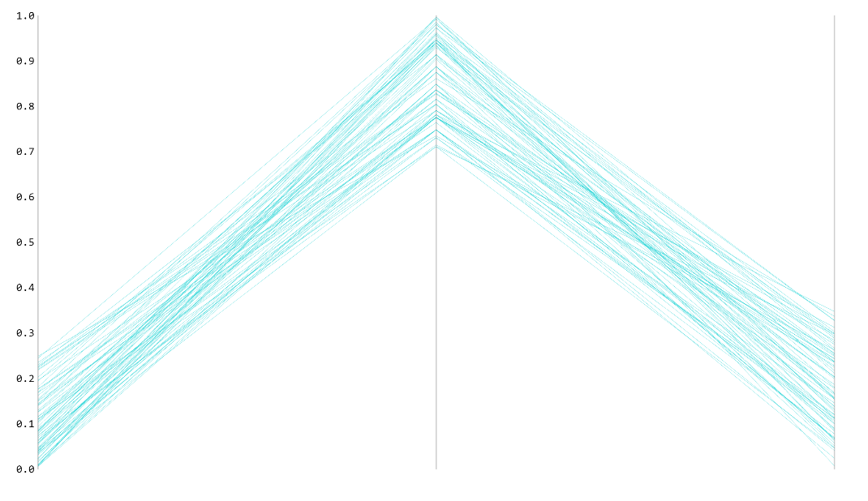
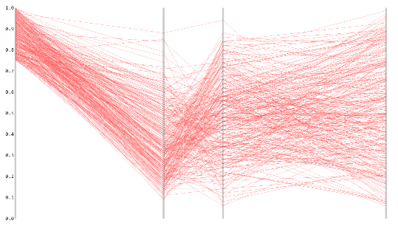
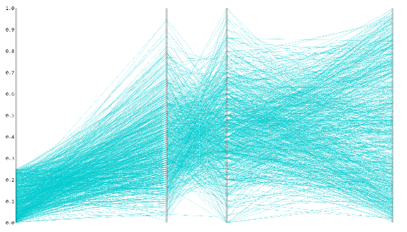
Breaking down outliers from p.1
SIZE
QUALITY
COST
SIZE
QUALITY
COST

Slide 19
